Slide 1
Team Work

Slide 2
Teamwork Learning Objectives
Define teamwork.
Identify traits of a good and poor teammate
Recognize how to communicate effectively in teams.
Demonstrate positive group communication exchanges.
Understand the advantages and disadvantages of teamwork

Slide 3
Buzzer Beater
What is teamwork?
Think of a time when you’ve been part of a team:
What are 3 traits that make a good teammate? Poor teammate?
Identify some decisions the group had made, and the method used to make them.
Identify some roles that members of the group have played.
Did the group have a leader? If so, what style did the leader have?
Notes:
Use polleverywhere, have group discussion, post-it notes, team discussions with a designated team leader to give the answers to the class etc.
Good Teammate options
1. Selflessness
2. Communication
3. Accountability
4. Competitiveness
5. Confidence
6. Be Respectful
7. Trusting
8. Positive Attitude
9. Dependability
10. Have Fun
Challenging teammate options
Inconsideration
Rudeness
Apathy
Domination
Irresponsibility

Slide 4
Team Challenge
You are stuck on a deserted island. In order to protect you from the elements, you will need to build a shelter big enough to house the entire team. The structure must be free standing and be built with only the newspaper and tape provided. You will have 3 minutes to plan how you are going to build the structure. Immediately when the time is up, you have 10 minutes to build the group shelter. When the 10 minutes expires, all members need to be in/under the shelter.
HERE IS THE CATCH:
After the 3 minutes is up, NO TALKING IS ALLOWED
Yep...no talking.
Notes:
The students should be in the same groups that they were in the previous class period where they learned about work ethic. Tell them to consider the traits of a good teammate and a challenging teammate that they just listed and try to be a good teammate during the “build a shelter” exercise.

Slide 5
Team Challenge
You are stuck on a deserted island. In order to protect you from the elements, you will need to build a shelter big enough to house the entire team. The structure must be free standing and be built with only the newspaper and tape provided. You will have 3 minutes to plan how you are going to build the structure. Immediately when the time is up, you have 10 minutes to build the group shelter. When the 10 minutes expires, all members need to be in/under the shelter.
HERE IS THE CATCH:
After the 3 minutes is up, NO TALKING IS ALLOWED
Yep...no talking.
Notes:
The students should be in the same groups that they were in the previous class period where they learned about work ethic. Tell them to consider the traits of a good teammate and a challenging teammate that they just listed and try to be a good teammate during the “build a shelter” exercise.

Slide 6
Team Challenges
In your teams:
Discuss and list 3-5 ways your team worked well together during the “build a shelter” exercise
Discuss and list 3-5 challenges/difficulties that you faced during the “build a shelter” exercise
Notes:
Allow 1-2 minutes. After they have discussed them in their groups, ask a few of them to share with the class. Did these challenges matchup to those you identified in your bell ringer? How did the inability to talk to your team members affect the difficulty of the project.

Slide 7
Teamwork
Definition (Otto and Wood, 2000)
A team is “… two or more persons engaged in a common goal, who are dependent upon one another for results, and who have joint accountability for the outcomes.”

Slide 8
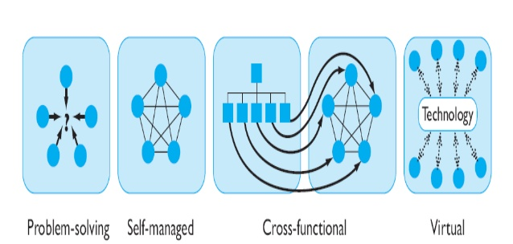
Type of Teams
Notes:
http://www.sydney.accountantsrc.com.au/student/L04%20Team%20Work/L4%20Team%20Work.pdf
https://www.slideshare.net/ashfaqafridi2/understanding-workteams

Slide 9
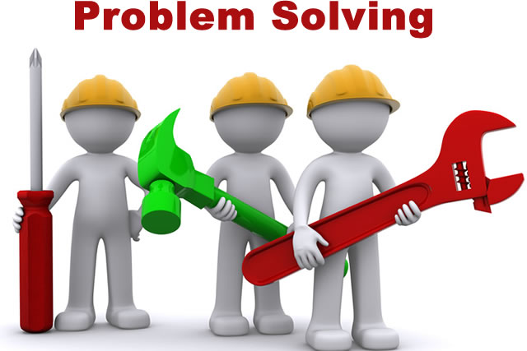
A team of employees from the same department who meet each week to discuss how to improve service quality.
Notes:
Share ideas or offer suggestions on how work processes and methods can be improved
Rarely given authority to implement any of their suggested actions
http://www.tbae.co.za/images/problem-solving-outcome-based-team-building.jpg

Slide 10
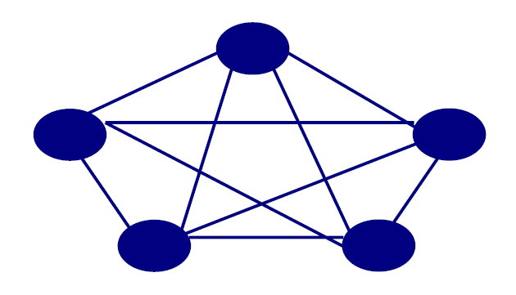
Self-Managed Teams
A team of people who take on a project with autonomy from their Supervisor or Manager.
Notes:
• Typically 10-15 employees
• Team takes on supervisory responsibilities in addition to job tasks.
• Select and evaluate members
• Effectiveness is situationally dependent
• Self managed work team are groups of employees who perform highly related jobs and take on many of the responsibilities of their former supervisors.
• Typically this includes planning and scheduling of work, assigning task to members, collective control over the pace of work, making operating decision, taking action on problems and working with suppliers and customers.
http://www.pathways.cu.edu.eg/subpages/training_courses/teams/images/2_3.gif

Slide 11
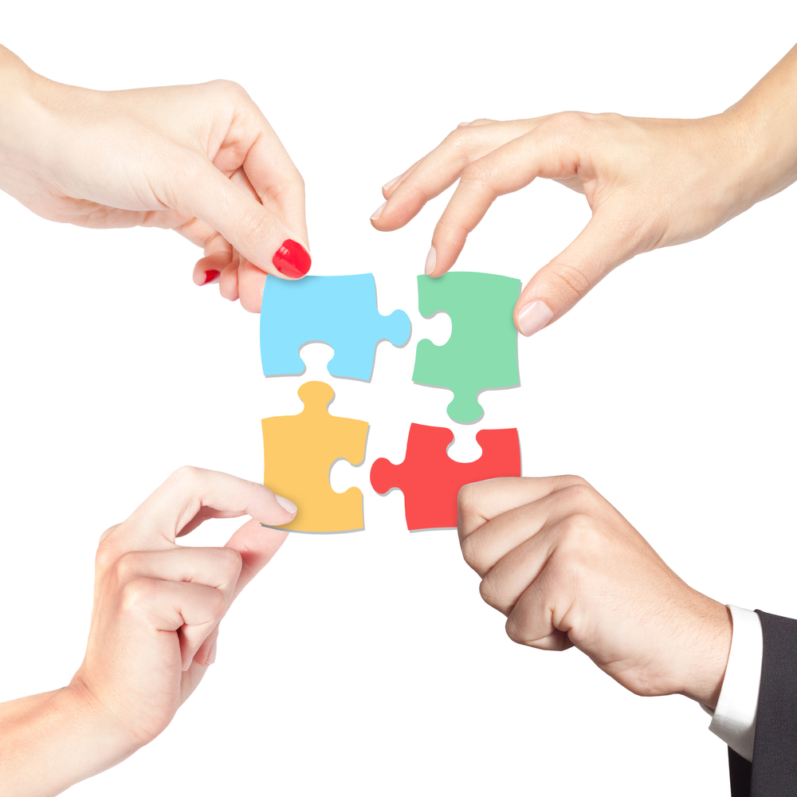
Cross-functional Teams
Employees from same hierarchical level, but different work areas, who come together to accomplish a specific task.
Notes:
Members from diverse areas within and between organizations
• Exchange information
• Develop new ideas and solve problems
• Coordinate complex projects
• Development may be time-consuming due to complexity and diversity
http://cerasis.com/wp-content/uploads/2014/01/logistics-collaboration.jpg

Slide 12

Virtual Teams
Teams that use computer technology to tie together physically dispersed members to achieve a common goal.
Notes:
• Computer technology ties physically dispersed members together to achieve a common goal
• Differentiating factors from other teams – Absence of non-verbal cues – Limited social context – Ability to overcome time and space constraints
http://hiverhq.com/blog/wp-content/uploads/2016/04/virtual1.jpg

Slide 13
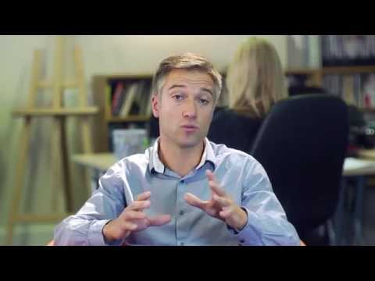
Stages of Teams
Forming
Storming
Norming
Performing
Notes:
2 minutes long: Show video that explains the stages of teams
Forming: the team meets and members go through the initial stages of finding out about each other and the leader, learning about what their own role is going to be, and trying to define the team’s task.
Storming: once the team has become established, conflict arises as differences in approach, attitude and methodology emerge, and members have to make adjustments to allow for these. Team members also have to adjust to and accept the team leader (if there is one). It is important at this stage for the leader to keep the group focused on its goals and to help it develop ways of working towards these.
Norming: after the period of adjustment, team members begin to settle down and work with each other. Relationships develop, and each member begins to feel a sense of belonging and of contributing. Group norms emerge and the team begins to make progress towards achieving its goals.
Performing: by now team members are familiar with each other and the leader and their own role, and are seeing some results from their efforts. The team is able to make decisions and solve problems.

Slide 14
Effective Teams
Build Constructive relationships
Open exchange of ideas, opinions, and perspectives
Show mutual respect, develop trust and support
Mutually influence one another
Manage differences successfully
Spend time and effort on the ‘people’ or team aspects just as you plan to spend time on actual design tasks

Slide 15
Effective Teams
Establish clear rules of behavior (must communicate & agree to accept them)
Work towards consensus
Define a process to resolve conflicting goals, objectives and/or requirements (a priori --- not after problems exist!)
Ensure/allow/require everyone to participate
Effective Communication is the key!
Active conformation of ideas, assignments etc

Slide 16
Advantages of Teamwork
Large problems need more people to resolve
Where a range of specialist skills needed
More ideas generated
Teams can provide support
More resources available
Increased networking opportunity
Increased professional development

Slide 17
Disadvantages of Teamwork
Split decisions may cause divisions or resentment
Costs – may take time and resources to get set up
Slowness - may take more time to make decisions
Groupthink – less open to new ideas
Conflict – may occur between team members
Compromise – may not be the best possible solution

Slide 18
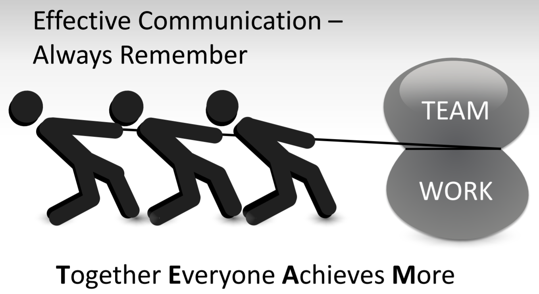
Notes:
http://www.sydney.accountantsrc.com.au/student/L04%20Team%20Work/L4%20Team%20Work.pdf

Slide 19
In your teams…
Kinex bridge building challenge.
The Marshmellow Challenge-- https://www.ted.com/talks/tom_wujec_build_a_tower
Marker Challenge
Paper Airplane Challenge
Notes:
Based on the new information you have about working in teams, work on this second team activity and apply some of your knowledge.

